Slide 1
8th form lesson 5 module 4
Mrs salwa ben mahmoud

Slide 2
Sporting activities

Slide 3

Do you like sport ?
LOOK at the pictures and complete the sentences :

Slide 4
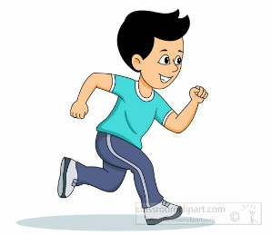
jogging/ CYCLING
1.Boblikes……………………

Slide 5
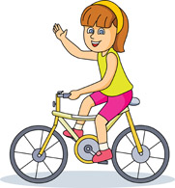
swimming/Cycling
2.The girl is good at ……………………………………

Slide 6
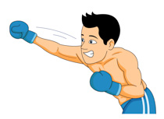
Fighting/boxing
4.Peter enjoys …………………………………………

Slide 7
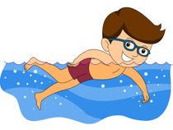
Diving / swimming
5………………………………………is Steve’s favourite sport

Slide 8
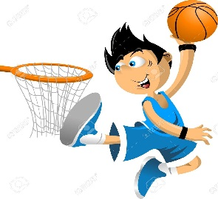
Playing basketall/playing baseball
6…………………………………. is my favourite hobby

Slide 9
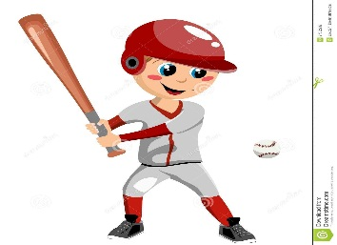
Playing tennis / playing baseball
7………………………………………. is Lina’s favourite pastime

Slide 10
The Gerund (Verb+ing) can be used as a subject or object in a sentence exp:
Swimming is my favourite pastime.
……………………
My favourite pastime is swimming.
………………..

Slide 11
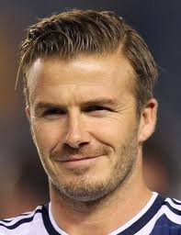
Who’s this?

Slide 12
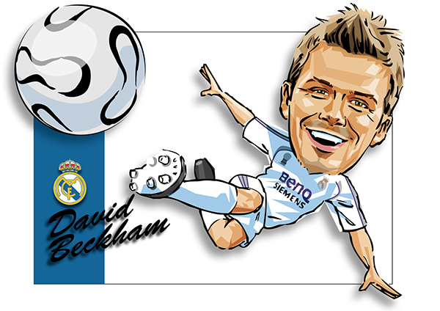
GOOD
It’s David Beckham

Slide 13
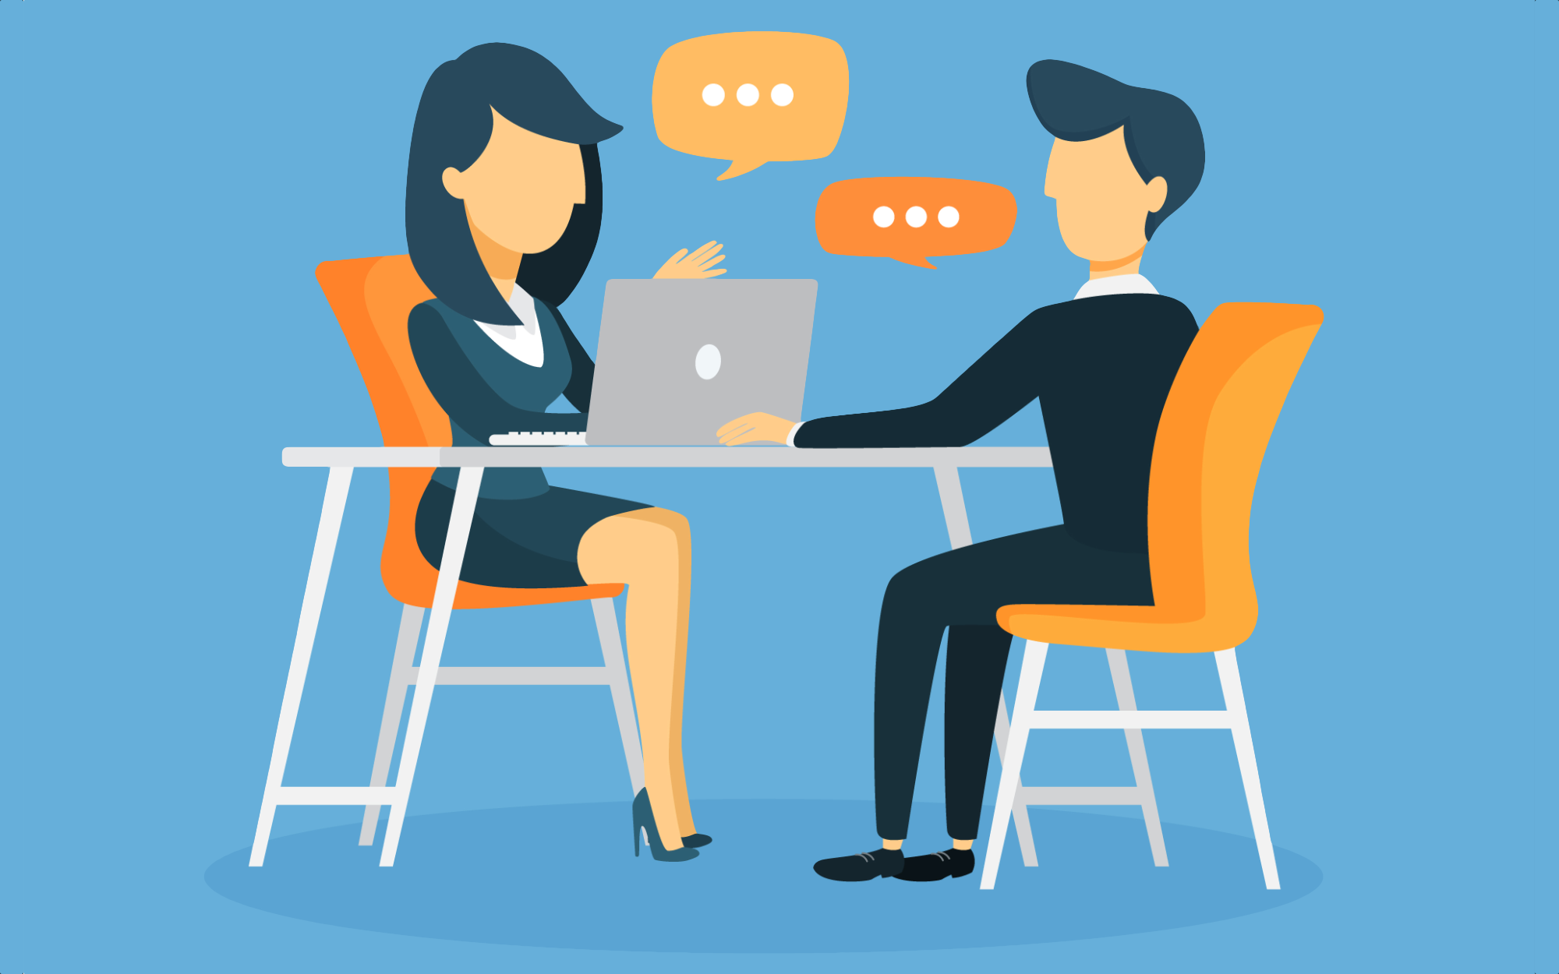
Reading
Read the interview p 79 and answer the questions :

Slide 14
The interview p 79
Journalist :Thank you David for accepting to be with us .
David :Thank you for inviting me .
Journalist : Tell me David , why do people practice sport ?
David : Well , first they do it for the enjoyement .Sporting activities are a lot of fun .Besides ,when we train and play hard we become fitter , our bodies become stronger .
Journalist : I totally agree with you . What else can we get from sport ?
David : A sense of success : when people succeed in a game , they feel good and think that they can succeed in other things : their studies ,their jobs etc………….
Journalist :I see a sound mind in a sound body .
David : Exactly .
Journalist : Do you need to be good to succeed ?
David : Not at all .Winning isn't everything .Participating is what matters ..However , people often forget that .
Journalist :Thank you David .Good bye .
David : It's my pleasure .

Slide 15
a- David Beckham is (a handball player-a tennis player-a football player ) .
b-David and the journalist talked about :
-The olympic games / -How to succeed in your job / benefits of sport .
c-According to David why should people practice sport ?
……………………………. ……………………………..
……………………………. ………………………………

Slide 16

d-Did the journalist agree with him ? If yes , pick up two expressions that express agreement :
………………………………………………………..
………………………………………………………………

Slide 17

f-Now , find an expression that express disagreement : - …………………………………………….
.

Slide 18
++++
What are the benefits of sports according to Beckham:
………………………………………………………………
………………………………………………………………………
………………………………………………………………………

Slide 19
When we train, we become fitter and fitter
Our bodies become stronger and stronger
Short adjective + er + and + short adjective + er

Slide 20
exercice
-a- What do the following sentences express , circle the suitable answer :
-The bear got closer and closer .
-She ran faster and faster .
-He became stronger and stronger .
(comparison – description –gradual change )
b-Use the double comparative :
-Mother: Dave , you are getting(fat)………………and…………………. .
-Dave: So what ?
-Mother: Well , you should eat(little)……………..and………………… .
-Dave : I can't mum, I can't !
-Mother: Then, you should be(active)………………….and…………………. ……………………..,you can for example practice sport .
-Dave :But this year ,I'm having (much)…………………..and …………… work to do.

Slide 21
writing
Tell us about the benefits of the sport that you practise . !!

Slide 22

See you

